Slide 1
High-resolution constraints on North American and global methane sources using satellites
Harvard: Daniel Jacob, Bram Maasakkers, Melissa Sulprizio, Alex Turner
JPL: Kevin Bowman, Anthony Bloom
EPA: Tom Wirth, Melissa Weitz, Leif Hockstad, Bill Irving
Satellite data
SCIAMACHY
2002-2005
TROPOMI
2016-
GOSAT
2009-
Geostationary
OSSE
Suborbital data
Bottom-up (prior)
SEAC⁴RS, SENEX
EDGAR v4.2 + LPJ
Gridded EPA inventory
New wetland inventory
GEOS-Chem CTM and adjoint
1/2ºx2/3º over N. America
nested in 4ºx5º global
Aircraft campaigns
Surface networks
Bayesian
inversion
Validation
Verification
Optimized emissions at up to 50 km resolution

Slide 2
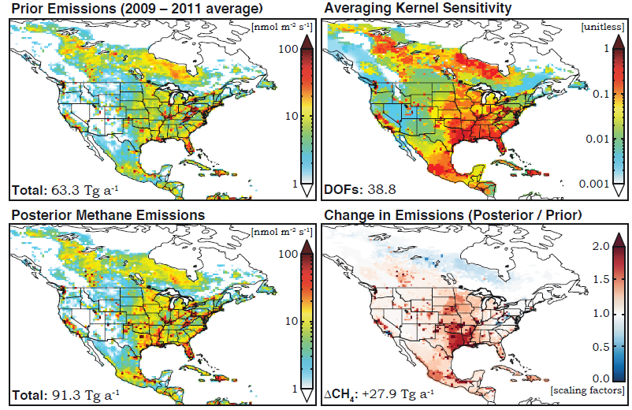
Inversion of GOSAT 2009-2011 data
Turner et al., in prep.

Slide 3
Construction of a 0.1ºx0.1º monthly gridded version of the EPA national bottom-up inventory
Use monthly state/county/GGRP/algorithm info from EPA, further distribute with data from other sources (USDA, EIA, DrillingInfo,…)
Done as collaboration between Harvard and EPA Climate Change Division
Provide improved prior for inversions and feedback to guide improvement in bottom-up inventory
Livestock (manure)
EDGAR, 2010
Livestock (manure)
EPA, 2012
Livestock (manure)
EPA-EDGAR
Maasakkers et al., in progress

